Slide 1
Veracode / CA Developing a Security Culture in the Agile / DevOps Accelerated Development Environment
September 2017
Joost de Jong
Notes:
This PowerPoint Template includes a series of slide masters with predefined layouts and color schemes for formatting slides
Slide Masters are displayed when you right click on a slide and select Layout from menu

Slide 2
About Veracode
Veracode in Broad Strokes:
Headquartered in Boston, USA
Founded in 2006, Division of CA
Europe HQ in London UK
550 Staff, 350 Engineers
Dedicated and focused on Application Security Testing
Mantra: Leading the way towards the integration of security in all phases of the software development life cycle (DevSecOps)

Slide 3
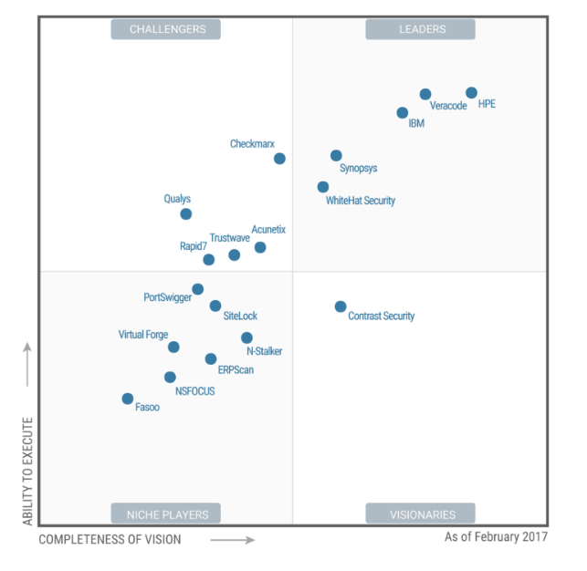
The analyst view: Gartner
Description
Veracode is a well-established global AST provider with a strong presence in the North American market as well as presence in the European market. Veracode's offering includes SAST, DAST and SCA cloud services, as well as IAST (and RASP).
In the last 12 months, Veracode launched Greenlight, a SAST service to be used early on in the development process by integrating into the IDE to scan an individual class or file. In addition to Greenlight, Veracode provides the Developer Sandbox, which can statically scan an application or component and measure results without impacting or penalizing developer metrics. Veracode focused some of its recent efforts on extending its language and framework support, as well as SDLC integration, and most recently it announced a single instrumentation agent to provide IAST and RASP capabilities.
Veracode will meet the requirements of organizations looking for a broad set of AST services and that want support for their AST and SCA from a third-party expert with a comprehensive AST solution.

Slide 4
CA / Veracode
Key Objectives:
+ Set Corporate Policy: Both Internal & External Development
+ Enable Agile / DevSecOps

Slide 5
DevSecOps
It is not just a question of purchasing the right tools
Dev
Ops
Sec
Engaged Stakeholders
+ Development
+ Security / Risk
+ Management
+ Consumers

Slide 6
Automate & Integrate Throughout App Lifecycle
Build or Buy
Test
Operate
Code
Commit
Build
Test
Release
Deploy
Operate
DevOps
Agile
CI/CD
Continuous Testing & Integration
Continuous Scanning & Protection
Security Assurance
Veracode Web Application Scanning (WAS)
Dynamic Analysis (DAST)
Greenlight
Veracode Static Analysis (SAST)
Veracode Runtime Protection (RASP)
eLearn
Veracode Software Composition Analysis
Veracode APIs for Custom Integrations
IDEs
Build Tools
CI/CD Systems
Bug Tracking
GRCs
SIEMs
WAFs

Slide 7
A Lifecycle Approach Reduces Cost, Risk
$15.4 million
*Verizon Breach Report, 2015
$
Cost to Remediate
$
Exploit
$
Develop
QA
Operate
Application Lifecycle

Slide 8
Static Analysis for all development stages
9
8
Enterprise
Import
Policy
Scan
3
5
Veracode Application Security Platform
User stories
Features / Defects
Greenlight Scan
Sandbox Scan(s)
Personal
Team
1
2
4
7
Develop
Early Dev
Mid to late
Dev
Build
6
Check In
5
&
8
= 1x App Profile / License (<50mb) – unlimited scanning
Automated
3
= Developer User License(s) – unlimited scanning
Veracode Plugin

Slide 9
Managing Vulnerabilities over Time
Start Measuring
Apply Policy
eLearning
Control # Vulnerabilities over time
# vulnerabilities
# time

Slide 10
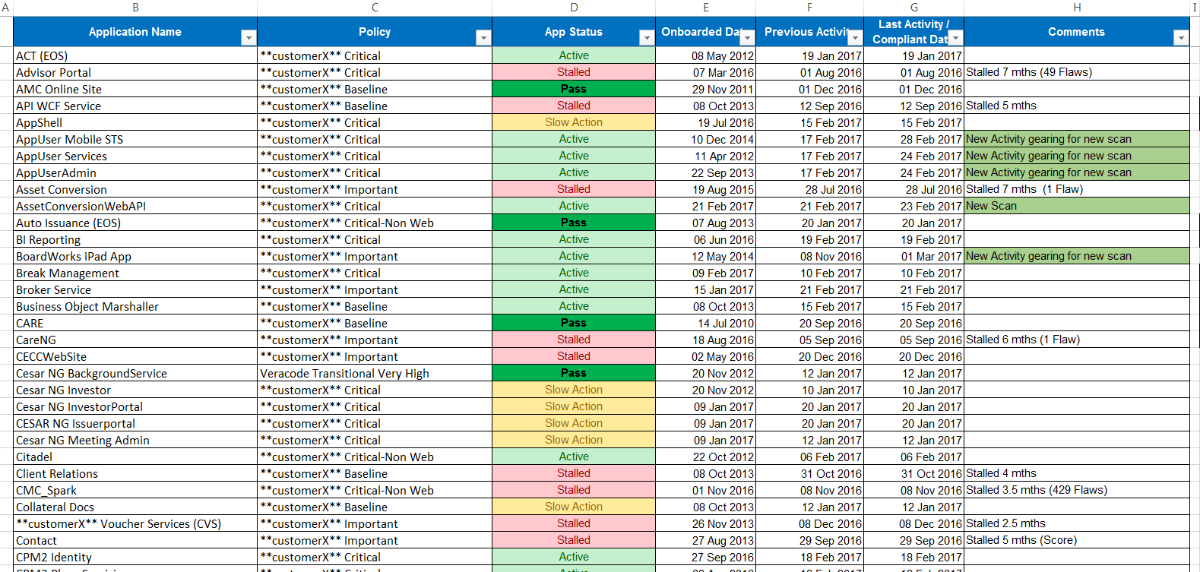
Centralized Administration & Performance Tracking

Slide 11
Applying Policy to Development
Policy
Specific to Application Compliance Requirement: PCI, OWASP, SANS, CERT, or specific to regulatory environment
Consolidated 1st Party Code + 3Rd Party Modules scan
Frequency of Scanning
Remediation Times according to Severity of Vulnerability
Security: Accept/Deny: False Positives

Slide 12
Veracode Static Analysis Efficient Licensing/Collaboration
App Profile
(1x Veracode Annual Subscription)
Policy Scan
(used by Security Team for assurance and compliance reporting)
Sandbox 1 –
E.g. Aggregated App
Promote to Policy Scan
Sandbox:
Provides private scanning area for development teams
Does not impact Compliance of application
Typically integrated into CI/Build Server and performed nightly/weekly
Developers can identify and resolve policy violating flaws prior to performing a Policy Scan
For Multi-Tier / Multi-Team Applications, Sandbox is used to enable independent scanning per team – aligning to pace of team(s) and eliminating over-reporting flaws
A Sandbox can be promoted to become a Policy Scan
Important – No Governance and/or Compliance reporting on individual Sandboxes within an App Profile (if this is needed, a separate App Profile and License is needed)
With Sandboxes, you benefit from having up to 5 concurrent scans running under a single App Profile
Unlimited access to all automation/integration options per Sandbox, and unlimited user access
Sandbox 2 –
E.g. Java
Sandbox 3 –
E.g. .Net
Sandbox 4 –
E.g. Backend
Sandbox n -

Slide 13
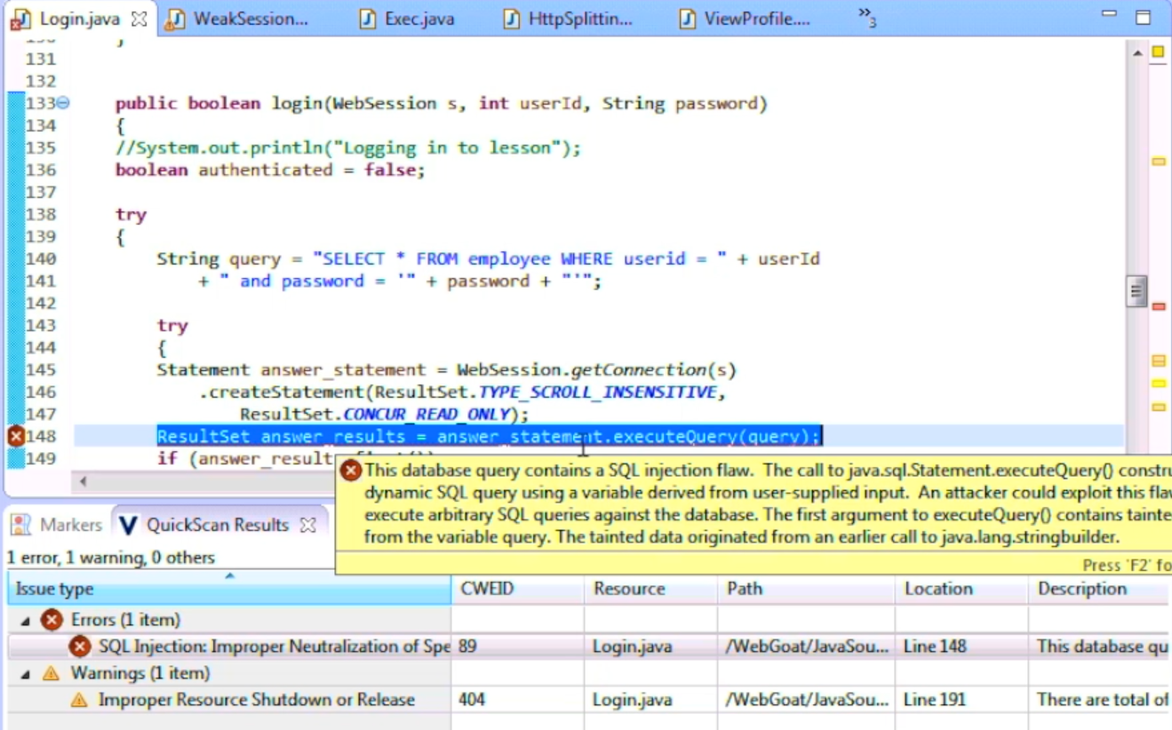
Greenlight: Security Testing
Who is it for?
Developers seeking the fast, frequent security testing, early in the Development lifecycle.
What is it?
Allows Developers to discover security-related defects before committing code, so they can fix security flaws before they change context, all from within their IDE.
How does it work?
Scanning code snippets, files, classes or whole projects are initiated from the IDE with results delivered back to the IDE in seconds. Defects are found and fixed before code is ever checked in.

Slide 14
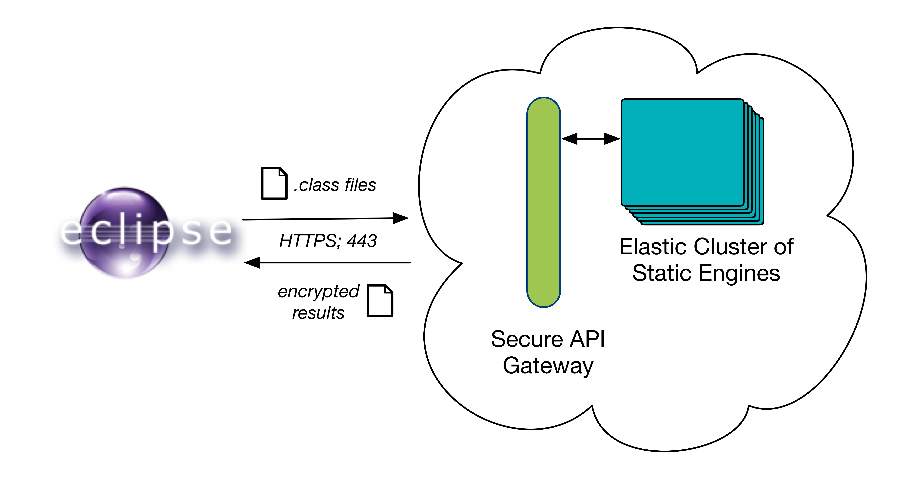
Greenlight: Testing Architecture

Slide 15
SCA: Why scan 3rd party code?
Input
Uploaded Application
Including 3rd-party components in the analysis increases accuracy.
Most developers use standardized sanitization functions in 3rd party components rather than writing their own. Excluding 3rd party code therefore hurts accuracy.
Example: A tainted input value is sanitized using a function in a 3rd-party component. If Veracode omitted the 3rd-party component in the analysis, the solution would show up as a false positive.
Tip: Solutions that analyze source code rather than binaries cannot scan compiled 3rd-party components and therefore have a higher false positive rate. Many companies don’t have ready access to source code, even when components are open source, increasing their false positive rate.
1st Party Code
3rd Party Component
Sanitization
Data Flow
Output
3rd Party Component
Images & Videos
Unused 3rd Party Component
Included in Analysis Size
Not included in Analysis Size

Slide 16
SCA:Report Flaws in 3rd Party Code?
Input
Uploaded Application
We typically do not recommend reporting on flaws in 3rd party code using Veracode Static Analysis.
Most customers can’t or don’t want to fix vulnerabilities in 3rd-party code by changing the code themselves. Therefore, they don’t want to muddy their reports (and policy results) with these vulnerabilities.
Tip: Use Veracode Software Composition Analysis (SCA) to find publicly known vulnerabilities in 3rd-party components. Veracode SCA will also tell you if there is a newer version of the component that fixes the vulnerability.
1st Party Code
3rd Party Component
Data Flow
Output
3rd Party Component
Images & Videos
Unused 3rd Party Component
Report flaws found in code
Do not report flaws

Slide 17
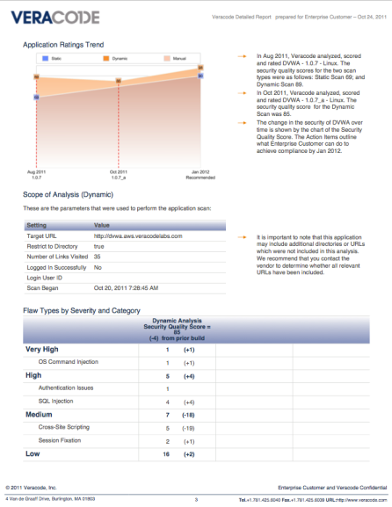
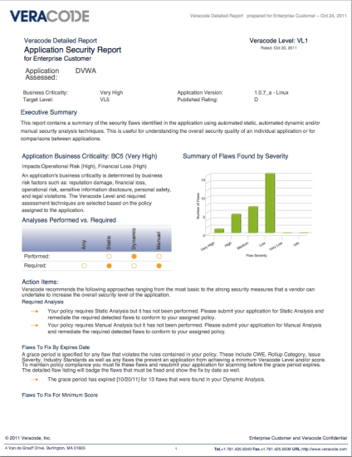
DAST: Dynamic Scanning
Test any web application with as little as a URL
Easy to get started
Simple, intuitive workflow
Scalable – run multiple scans in parallel
Multiple authentication schemes
Scans can start immediately or in the future
Behind the firewall scanning for internal apps

Slide 18
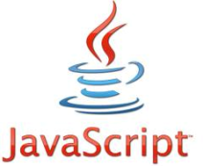
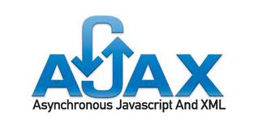
DAST: Testing Capabilities
Veracode developed dynamic scanning technology
Support for the latest Web 2.0 technology
JavaScript, AJAX and Flash object analysis supported
Designed to scale in production or behind-the-firewall
Testing Capabilities
Cross-site scripting
SQL injection
“Blind” SQL injection
SQL Injection auth bypass
CSRF
Backup file detection
Cross-site trace
Information leakage
Session fixation
CRLF injection
OS Command Injection
SSL Certificate issues
SSL Strength Analysis
Improper authentication
Browsable directory
Sensitive files & paths
Remote File Inclusion
Clickjacking
HTTP only and Secure cookie flags
Shellshock

Slide 19
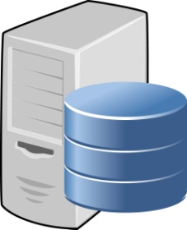
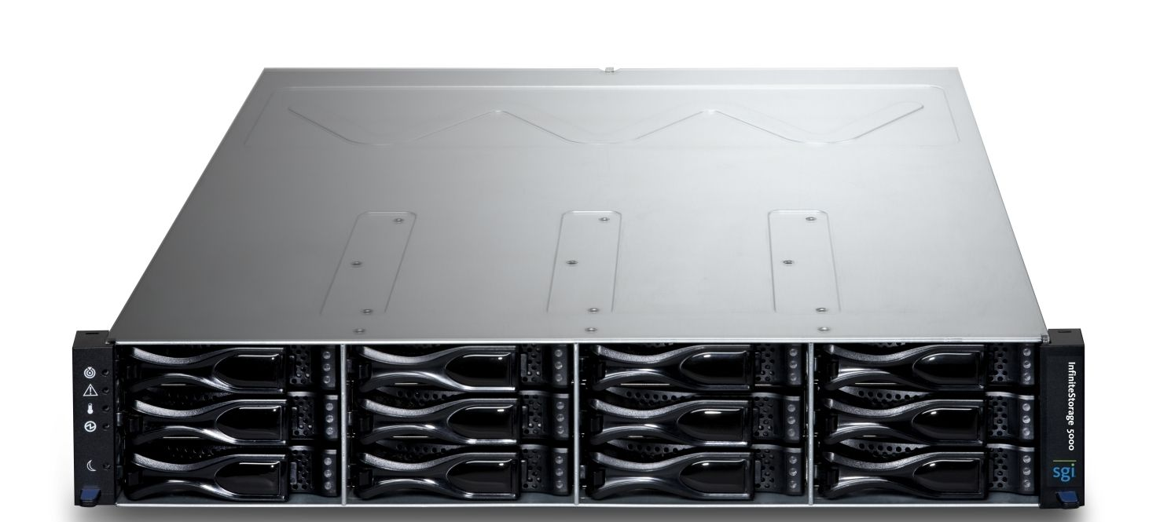
DAST: Continuous Integration
3
Scan from the Veracode Cloud or Virtual Scan Appliance
Dynamic Scan APIs
Configure scans
Schedule scans
Fetch detailed results
Immediately initiate Dynamic Scans via the Dynamic Rescan API
1
Builds deployed to QA environment
2
Build
Test
Automated results integration
4

Slide 20
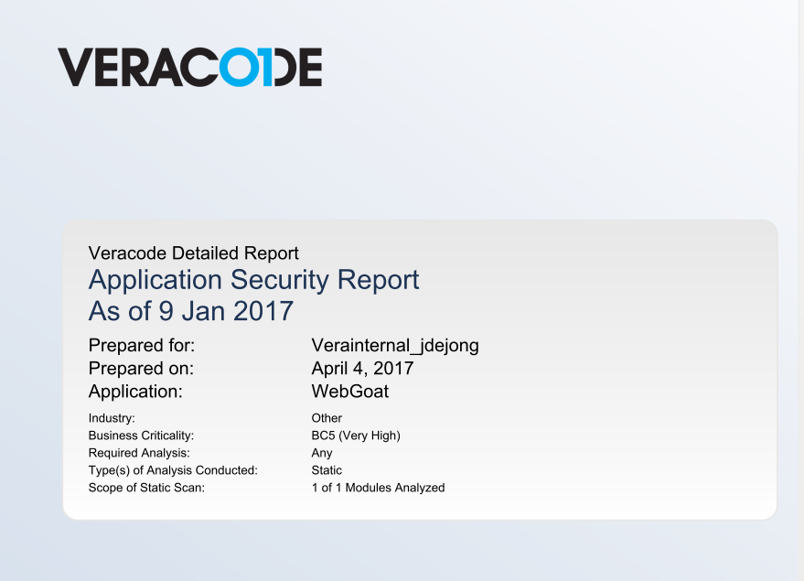
Compliance Reporting
Regulatory Documentation

Slide 21
AppSec Program: Phases
Definition
Execution
Optimization
Application Portfolio
Initial Communication
Onboarding
Assessments
Remediation
Integrations
Program Oversight
Reporting & Analytics

Slide 22
Thank You
Notes:
This PowerPoint Template includes a series of slide masters with predefined layouts and color schemes for formatting slides
Slide Masters are displayed when you right click on a slide and select Layout from menu

